Slide 1
Breast Cancer Disease Detection and Heart Disease Detection using Federated based Machine Learning and Ensemble Learning
Supervisor: Dr. Arindam Sarkar, HOD, Department of Computer Science and Electronics, RKMV
A Federated Learning Approach
29th April 2023
1/80

Slide 2
Presented By:
Bikram Halder,Sankhadeep Mukherjee, Rajdeep Mandal
B.Sc. Computer Science
College Roll No: 312,295,293
Students of Department of Computer Science and Electronics
Ramakrishna Mission Vidyamandira, Belur Math
A Federated Learning Approach
29th April 2023
2/80

Slide 3
AGENDA
Abstract
Introduction
Contribution of the project
Background Knowledge
Literature Survey
Research Methodology
System Configuration
Dataset Description
Experimental Results
Comparison Table
Conclusion
Limitation
Future Scope
Bibliography
A Federated Learning Approach
29th April 2023
3/80

Slide 4
ABSTRACT
A Federated Learning Approach
29th April 2023
4/80

Slide 5
ABSTRACT
We focus on developing and evaluating machine-learning models for breast cancer prediction and heart disease prediction. The models used in this project include AdaBoost, Linear Discriminant Analysis (LDA), [13] Decision Tree (DT), Random Forest, Gaussian Naive Bayes, Bagging, Gradient Boost and Extra Trees Classifier (ETC), and [1] Federated Learning techniques were also applied to improve the accuracy of the model.
The results of comparative study on Breast Cancer Dataset show that the best model had an accuracy of 96.49%, while the federated-based best model had an accuracy of 98.48%, demonstrating the potential of Federated Learning in enhancing the accuracy of machine learning models.
The results of comparative study on Heart Disease Dataset show that the best model had an accuracy of 98.64%, while the federated-based best model had an accuracy of 98.64%, demonstrating the potential of Federated Learning in enhancing the accuracy of machine learning models.
A Federated Learning Approach
29th April 2023
5/80

Slide 6
INTRODUCTION
A Federated Learning Approach
29th April 2023
6/80

Slide 7
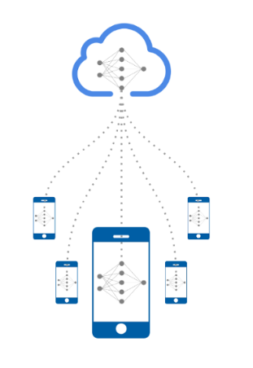
FEDERATED LEARNING
Collaborative Machine Learning without Centralized Training
Data.
Key Features :
Privacy and Security
Collaborative Learning
Robustness
Personalization
A Federated Learning Approach
29th April 2023
7/80

Slide 8
FEDERATED LEARNING
Downloading a global model and uploading local parameters at the same time leads to a network.
Straggler effect :
Client devices are heterogeneous.
Hardware and network connections are unreliable.
Server needs to wait for the slowest devices to respond.
Differential privacy :
Adding noisy data makes it difficult to discern real information in case of data leaks.
A Federated Learning Approach
29th April 2023
8/80

Slide 9
Why Federated Learning ?
Federated learning is an emerging area in the machine learning domain and it already provides significant benefits over traditional, centralized machine learning approaches. The benefits of federated learning are -
Data security: Keeping the training dataset on the devices, so a data pool is not required for the model.
Data diversity: Challenges other than data security such as network unavailability in edge devices may prevent companies from merging datasets from different sources. Federated learning facilitates access to heterogeneous data even in cases where data sources can communicate only during certain times
Real-time continual learning: Models are constantly improved using client data with no need to aggregate data for continual learning.
Hardware efficiency: This approach uses less complex hardware, because federated learning models do not need one complex central server to analyze data
A Federated Learning Approach
29th April 2023
9/80

Slide 10
Disadvantages of Federated Learning
Investment requirements: Federated learning models may require frequent communication between nodes. This means storage capacity and high bandwidth are among the system requirements.
Even though only models, not raw data, are communicated to the central server, models can possibly be reverse engineered to identify client data. Privacy-enhancing technology like differential privacy, homomorphic encryption can be used to increase data privacy capabilities of federated learning.
Indirect information leakage: Researchers have considered situations where one of the members of the federation can maliciously attack others by inserting hidden backdoors into the joint global model.
Centralization: There is still a degree of centralization in federated learning where a central model uses the output of other devices to build a new model. Researchers propose using blockchained federated learning (BlockFL) and other approaches to build zero-trust models of federated learning.
A Federated Learning Approach
29th April 2023
10/80

Slide 11
CONTRIBUTION OF PROPOSED WORK
This project proposes a solution that combines machine learning and ensemble learning techniques with federated learning to address privacy, integrity, and ownership concerns when training AdaBoost, LDA, Random Forest, Gaussian Naive Bayes, Bagging, Gradient Boost, Decision Tree, and Extra Trees classifiers using IoT data from multiple providers.
To enable secure training on data with the help of federated learning, the project constructs secure protocols for crucial algorithms training operations while ensuring that data providers cannot access each other's data and that the data scientist’s model parameters are kept secret from the data providers during the training process.
A Federated Learning Approach
29th April 2023
11/80

Slide 12
LITERATURE REVIEW
These papers investigate the state of the art of various clinical decision support systems for human health disease prediction, proposed by various researchers using machine learning techniques.
A Federated Learning Approach
29th April 2023
12/80

Slide 13
LITERATURE REVIEW
REFERENCES | OBJECTIVES | CONTRIBUTIONS | LIMITATIONS | YEAR
[1] Q. Li et al., "A Survey on Federated Learning Systems: Vision, Hype and Reality for Data Privacy and Protection," in IEEE Transactions on Knowledge and Data Engineering, vol. 35, no. 4, pp. 3347-3366, 1 April 2023, doi:https://doi.org/10.1109/TKDE.2021.3124599. | Federated Learning, Machine Learning, Data Mining. | They provide a thorough categorization for federated learning systems according to six different aspects, including data distribution, machine learning model, privacy mechanism, communication architecture, the scale of the federation, and motivation of federation. | The paper may only focus on data privacy and protection issues and may not consider other important aspects of federated learning such as scalability, efficiency, and fairness. | 2023
[2] Amelia Jiménez-Sánchez, Mickael Tardy, Miguel A. González Ballester, Diana Mateus, Gemma Piella, Memory-aware curriculum federated learning for breast cancer classification, Computer Methods and Programs in Biomedicine, Volume 229,2023, 107318, ISSN 0169-2607, https://doi.org/10.1016/j. cmpb.2022.107318. | Improves convergence speed of FL model, better classification accuracy with imbalanced data. | The contribution of this paper is the introduction of a novel memory-aware curriculum learning approach for FL, which helps to prioritize the samples that are most important for training the model. | This paper can be pointed out, that the dataset used might not be representative of all types of breast cancers, and the proposed method might not generalize well to other medical imaging tasks. | 2023
[3] Yaqoob, Mateen & Nazir, Muhammad & Qureshi, Sajida & Al-Rasheed, Amal. (2023). Hybrid Classifier-Based Federated Learning in Health Service Providers for Cardiovascular Disease Prediction. Applied Sciences. 13. 1911. 0.3390/app13031911. DOI : https://doi.org | Heart disease prediction; hybrid technique; ABC-SVM; privacy-awar e machine learning; intelligencebased healthcare. | They propose a hybrid framework at the client end of HSP consisting of modified artificial bee colony optimization with support vector machine (MABC-SVM) for optimal feature selection and classification of heart disease. | Small sample size, lack of diversity in the dataset, and potential biases in data collection and model development. | 2023
[4] Zhang, Tianyu & Tan, Tao & Han, Luyi & Appelman, Linda & Veltman, Jeroen & Wessels, Ronni & j Breast Cancer. 9. 10.1038/s41523-023-00517 -2. DOI:https://doi.org/10.10 38/s41523-023-00517-2 | Multi-modal deep learning with intra- and inter-modality attention modules (MDL-IIA). | In this study, they develop a deep learning-based model for predicting the molecular subtypes of breast cancer directly from the diagnostic mammography and ultrasound images | This paper could include small sample sizes, potential biases, lack of generalizability to other populations, and incomplete data analysis. | 2023
Subha Roy
Smart Healthcare and Smart Agriculture
12th April 2023
4/

Slide 14
LITERATURE REVIEW
REFERENCES | OBJECTIVES | CONTRIBUTIONS | LIMITATIONS | YEAR
[5] Li, Lingxiao & Xie, Niantao & Yuan, Sha. (2022). A Federated Learning Framework for Breast Cancer Histopathological Image Classification. Electronics. 11. 3767. 10.3390/electronics112237 67. DOI :https://doi.org/10.3390/e lectronics11223767 | Federated learning; knowledge fusion; medical image diagnosis; breast cancer; histopatholo gy; image classification | They propose a federated learning framework, which allows knowledge fusion achieved by sharing the model parameters of each client through federated training rather than sharing data. | This paper is not available as it requires a detailed analysis of the paper.. | 2022
[6] G. N. Ahmad, H. Fatima, S. Ullah, A. Salah Saidi and Imdadullah, "Efficient Medical Diagnosis of Human Heart Diseases Using Machine Learning Techniques With and Without GridSearchCV," in IEEE Access, vol. 10, pp. 80151-80173, 2022, doi:https://doi.org/10.110 9/ACCESS.2022.3165792. | Heart disease,supp ort vector machine (SVM),logisti c regression (LR),gradient boosting classifier (GBC),GridSe archCV. | It is evident that amongst the proposed approach, the Extreme Gradient Boosting Classifier with GridSearchCV is producing the best hyperparameter for testing accuracy. The primary aim of this paper is to develop a unique model-creation technique for solving real-world problems. | This paper could include a small sample size, limited variety of heart diseases considered, and potential biases in the data used to train the machine learning models. | 2022
[7] G. N. Ahmad, S. Ullah, A. Algethami, H. Fatima and S. M. H. Akhter, "Comparative Study of Optimum Medical Diagnosis of Human Heart Disease Using Machine Learning Technique With and Without Sequential Feature Selection," in IEEE Access, vol. 10, pp. 23808-23828, 2022, doi: https://doi.org/10.1109/A | Heart disease,Cardi ac Disease sequential feature selection,DT, RF,SVM,GBC, LDA,confusio n matrix ⋅ ROC curve. | For both Hungary, Switzerland & Long Beach V and Heart Statlog Cleveland Hungary Dataset, Random Forest Classifier sfs and Decision Tree Classifier sfs produced the highest and almost identical accuracy values (100%, 99.40% and 100%, 99.76% respectively). | This paper could include limited sample size, lack of diversity in the data, and possible overfitting of the model due to the use of a single dataset. | 2022
[8] T. Gafni, N. Shlezinger, K. Cohen, Y. C. Eldar and H. V. Poor, "Federated Learning: A signal processing perspective," in IEEE Signal Processing Magazine, vol. 39, no. 3, pp. 14-41, May 2022, doi:https://doi.org/10.110 9/MSP.2021.3125282. | Deep learning,Trai ning data, Data privacy, Signal processing,C ollaborative work,Data models,Sens ors. | Learning in a federated manner differs from conventional centralized machine learning and poses several core unique challenges and requirements, which are closely related to classical problems studied in the areas of signal processing and communications. | This paper may include its narrow focus on the signal processing perspective of federated learning and potential omissions of relevant research from other fields. | 2022
Subha Roy
Smart Healthcare and Smart Agriculture
12th April 2023
4/

Slide 15
LITERATURE REVIEW
REFERENCES | OBJECTIVES | CONTRIBUTIONS | LIMITATIONS | YEAR
[9] Jiaqi Zhao, Hui Zhu, Fengwei Wang, Rongxing Lu, Hui Li, Jingwei Tu, Jie Shen, CORK: A privacy-preserving and lossless federated learning scheme for deep neural network, Information Sciences, Volume 603, 2022, Pages 190-209, ISSN 0020-0255, https://doi.org/10.1016/j.i ns.2022.04.052. | Model perturbation and distribution, Local training and encryption, Secure aggregation and model recovery. | In this paper, a privacy-preserving and lossless federated learning scheme, named CORK, is proposed for deep neural networks. | This paper could include a lack of comprehensive empirical evaluation and the assumption of a trusted third party in the federation, which may not always be feasible in practice. | 2022
[10] Ogundokun, Roseline & Misra, Sanjay & Maskeliunas, Rytis & Damaševičius, Robertas. (2022). A Review on Federated Learning and Machine Learning Approaches: Categorization, Application Areas, and Blockchain Technology. Information. 13. 263. 10.3390/info13050263. doi: https://doi.org/10.3390/i nfo13050263 | Blockchain Technology, Federated learning, machine learning, Preferred Reporting Items for Systematic Review and Meta-analysi s (PRISMA). | They discovered that the best results were obtained from the hybrid design of an ML ensemble employing expert features. | This paper focuses heavily on the technical aspects of Federated Learning and Machine Learning approaches and does not discuss the potential ethical, legal, and societal implications of their use in various application areas. | 2022
[11] Shaheen, Momina & Farooq, Shoaib & Umer, Tariq & Kim, Byung-Seo. (2022). Applications of Federated Learning; Taxonomy, Challenges, and Research Trends. Electronics. 11. 670. 10.3390/electronics110406 70. doi: https://doi.org/10.3390/el ectronics11040670 | Federated learning; edge devices; edge computing; IoT. | A taxonomy is also proposed on implementing FL for edge networks in different domains.Moreover, another novelty of this paper is that datasets used for the implementation of FL are discussed in detail. | This paper may include small sample sizes, biased data sources, lack of generalizability, or the possibility of unaccounted variables. | 2022
[12] A. Z. Tan, H. Yu, L. Cui and Q. Yang, "Towards Personalized Federated Learning," in IEEE Transactions on Neural Networks and Learning Systems, doi:https://doi.org/10.110 9/tnnls.2022.3160699. | Data models,Train ing,Adaptati on models,Colla borative work,Data privacy,Serv ers. | They explore the domain of personalized FL (PFL) to address the fundamental challenges of FL on heterogeneous data, a universal characteristic inherent in all real-world datasets. | This research paper could include factors such as limited scope of the study, potential biases, lack of generalizability, and unclear assumptions or methodology. | 2022
Subha Roy
Smart Healthcare and Smart Agriculture
12th April 2023
4/

Slide 16
LITERATURE REVIEW
REFERENCES | OBJECTIVES | CONTRIBUTIONS | LIMITATIONS | YEAR
[[13] Bharti, Rohit & Khamparia, Aditya & Shabaz, Dr. Mohammad & Dhiman, Gaurav & Pande, Sagar & Singh, Parneet. (2021). Prediction of Heart Disease Using a Combination of Machine Learning and Deep Learning. Computational Intelligence and Neuroscience. 2021. 10.1155/2021/8387680. doi : https://doi.org/10.1155/2 021/8387680 | Random Forest, Logistic Regression, KNeighbors, Support Vector Machine, XGBoost, Decision Tree, feature selection, Outliers Detection. | This paper can be combined with some multimedia technology like mobile devices is also discussed. Using a deep learning approach, 94.2% accuracy was obtained. | The paper's limitations could include the size and diversity of the dataset used for training and testing, the generalizability of the findings to larger populations, and the possible lack of explainability of the models' predictions. | 2021
[14] Y. Li, C. Chen, N. Liu, H. Huang, Z. Zheng and Q. Yan, "A Blockchain-Based Decentralized Federated Learning Framework with Committee Consensus," in IEEE Network, vol. 35, no. 1, pp. 234-241, January/February 2021, doi:https://doi.org/10.110 9/MNET.011.2000263. | A BC-built FL context with committee consensus, i.e., a distributed FL architecture founded on BC (BFLC). | A novel committee consensus technique has been presented that may effectively minimize the amount of consensus computation while also reducing malicious assaults. | Time complexity was not considered. | 2021
[15] Anna Karen Gárate-Escamila, Amir Hajjam El Hassani, Emmanuel Andrès, Classification models for heart disease prediction using feature selection and PCA, Informatics in Medicine Unlocked, Volume 19, 2020, 100330, ISSN 2352-9148, https://doi.org/10.1016/j.i mu.2020.100330. | Machine learning, Heart disease, Apache spark, PCA. | The experimental results proved that the combination of chi-square with PCA obtains greater performance in most classifiers.The usage of PCA directly from the raw data computed lower results and would require greater dimensionality to improve the results. | This paper has a limited sample size and does not provide information on the demographic characteristics of the study population. | 2020
[16] T. Mahmood, J. Li, Y. Pei, F. Akhtar, A. Imran and K. U. Rehman, "A Brief Survey on Breast Cancer Diagnostic With Deep Learning Schemes Using Multi-Image Modalities," in IEEE Access, vol. 8, pp. 165779-165809, 2020, doi:https://doi.org/10.110 9/ACCESS.2020.3021343. | Breast Cancer,comp uter-aided diagnosis,de ep learning techniques,m edical image analysis,lesio ns classification , segmentatio n. | This research also explores various well-known databases using ”Breast Cancer” keyword to present a comprehensive survey on existing diagnostic schemes to open-up new research challenges for radiologists and researchers to intervene as early as possible to develop an efficient and reliable breast cancer prognosis system using prominent deep learning schemes. | This paper may not account for the limitations and challenges faced by the proposed methods in real-world applications . | 2020
Subha Roy
Smart Healthcare and Smart Agriculture
12th April 2023
4/

Slide 17
LITERATURE REVIEW
REFERENCES | OBJECTIVES | CONTRIBUTIONS | LIMITATIONS | YEAR
[17] M. A. Rahman, M. S. Hossain, M. S. Islam, N. A. Alrajeh and G. Muhammad, "Secure and Provenance Enhanced Internet of Health Things Framework: A Blockchain Managed Federated Learning Approach," in IEEE Access, vol. 8, pp. 205071-205087, 2020, doi:https://doi.org/10.110 9/ACCESS.2020.3037474. | FL and discrepancy confidentialit y (DC) were suggested to preserve the confidentialit y and safety of IoHT data, allowing secluded IoHT data to be educated at the holder’s location. | The authors tackled the issue of incorporating lightweight security and privacy solutions into the FL ecosystem. | The accuracy and loss metrics values are very low and this can be improved in the future | 2020
[18] K. Salah, M. H. U. Rehman, N. Nizamuddin and A. Al-Fuqaha, "Blockchain for AI: Review and Open Research Challenges," in IEEE Access, vol. 7, pp. 10127-10149, 2019, doi: https://doi.org/10.1109/A CCESS.2018.2890507 | Survey on blockchain applications for AI | The review pieces of literature on emerging blockchain applications platforms, and protocol. | Privacy, smart contract security, trusted oracles, scalability, consensus protocols, standardization, interoperability, quantum computing resiliency and governance were not considered in their study. | 2019
[21] Theodora S. Brisimi, Ruidi Chen, Theofanie Mela, Alex Olshevsky, Ioannis Ch. Paschalidis, Wei Shi, Federated learning of predictive models from federated Electronic Health Records, International Journal of Medical Informatics, Volume 112, 2018, Pages 59-67, ISSN 1386-5056, https://doi.org/10.1016/j.imedinf.2018.01.007. | Algorithm for Cluster Primal-Dual Splitting. | Yield Classifiers with a small number of features. | For convergence, additional iterations are required. | 2018
[22] Z. Zheng, S. Xie, H. Dai, X. Chen and H. Wang, "An Overview of Blockchain Technology: Architecture, Consensus, and Future Trends," 2017 IEEE International Congress on Big Data (BigData Congress), Honolulu, HI, USA, 2017, pp. 557-564, doi:https://doi.org/10.110 9/BigDataCongress.2017. 85. | A comprehensi ve review of Blockchain Technology. | Over BC, BC architecture and core characteristics of BC were discussed in this study. | In-depth investigations on blockchain-based applications were not conducted | 2017
Subha Roy
Smart Healthcare and Smart Agriculture
12th April 2023
4/

Slide 18
BACKGROUND KNOWLEDGE
A Federated Learning Approach
29th April 2023
18/80

Slide 19

BACKGROUND KNOWLEDGE
CONFUSION MATRIX DETAILS
TP = True Positive
TN = True Negative
FP = False Positive
FN = False Negative
Precision or Positive Predictive Value (PPV) = (TP)/(TP+FP)
Recall or Sensitivity or True Positive Rate (TPR) or Hit Rate = TP/(TP+FN)
F1 Score or Harmonic Mean = (2*PPV*Recall)/(PPV+Recall)
F1 Measure = (PPV+Recall)/2
Specificity or True Negative Rate(TNR) or Selectivity = TN/(TN+FP)
Negative Predictive Value = TN/(TN+FN)
False Positive Rate = FP/(FP+TN)
False Negative Rate or Miss Rate = FN/(TP+FN)
False Discovery Rate = FP/(TP+FP)
A Federated Learning Approach
29th April 2023
19/80

Slide 20
BACKGROUND KNOWLEDGE
Critical Success Index or Threat Score(TS) = TP/(TP+FN+FP)
Fowlkes Mallows Index (FM) = sqrt(PPV*Recall)
Balanced Accuracy (BA) = (Recall+Specificity)/2
Matthews Correlation Coefficient (MCC) = (TP*TN-FP*FN)/(sqrt((TP+FP)\(TP+FN)*(TN+FP)*(TN+FN)))
Bookmaker Informedness or Informedness (BI) = Recall+Specificity-1 or TPR-FPR
Markedness or delta (MK) = PPV+NPV-1
False Omission Rate (FOR) = FN/(FN+TN)
Positive Likelihood Ratio (PLR) = Recall/FPR
Negative Likelihood Ratio (NLR) = FNR/Specificity
Prevalence Threshold (PT) = sqrt(FPR)/(sqrt(Recall)\sqrt(FPR))
Diagnostic Odds Ratio (DOR) = PLR/NLR
Accuracy = (TP+TN)/(TP+FP+FN+TN)
A Federated Learning Approach
29th April 2023
20/80

Slide 21
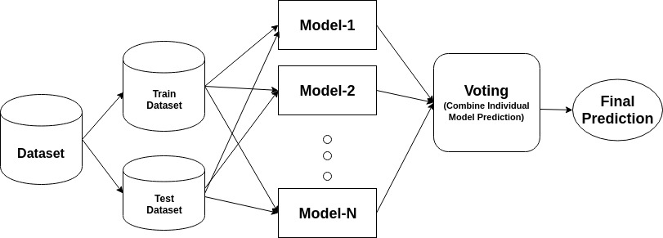
ADAPTIVE BOOSTING Algorithm
Step 1: Assign Equal Weights to all the observations. Initially assign same weights to each record in the dataset.
Step 2: Classify random samples using stumps.
Step 3: Calculate Total Error.
Step 4: Calculate Performance of the Stump.
Step 5: Update Weights.
Step 6: Update weights in iteration.
Step 7: Final Predictions.
A Federated Learning Approach
29th April 2023
21/80

Slide 22
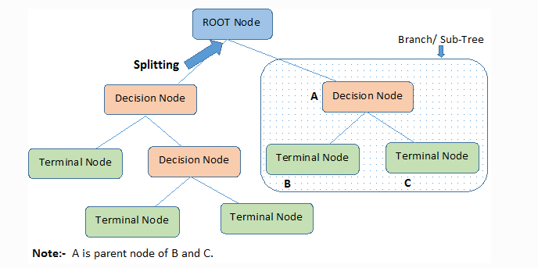
DECISION TREE Algorithm
Step-1: Begin the tree with the root node, says S, which contains the complete dataset.
Step-2: Find the best attribute in the dataset using Attribute Selection Measure (ASM).
Step-3: Divide the S into subsets that contains possible values for the best attributes.
Step-4: Generate the decision tree node, which contains the best attribute.
Step-5: Recursively make new decision trees using the subsets of the dataset created in step -3. Continue this process until a stage is reached where you cannot further classify the nodes and called the final node as a leaf node.
A Federated Learning Approach
29th April 2023
22/80

Slide 23
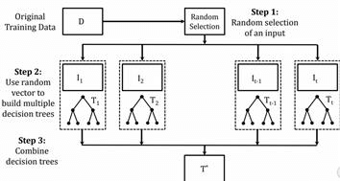
EXTRA TREE CLASSIFIER (ETC) Algorithm
The extra trees algorithm, like the random forests algorithm, creates many decision trees, but the sampling for each tree is random, without replacement. This creates a dataset for each tree with unique samples. A specific number of features, from the total set of features, are also selected randomly for each tree. The most important and unique characteristic of extra trees is the random selection of a splitting value for a feature. Instead of calculating a locally optimal value using Gini or entropy to split the data, the algorithm randomly selects a split value. This makes the trees diversified and uncorrelated.
A Federated Learning Approach
29th April 2023
23/80

Slide 24
MACHINE LEARNING ALGORITHMS(used for breast cancer dataset)
Decision Tree
Linear Discriminant Analysis
Adaptive Boosting (AdaBoost)
Extra Trees Classifier
A Federated Learning Approach
29th April 2023
24/80

Slide 25
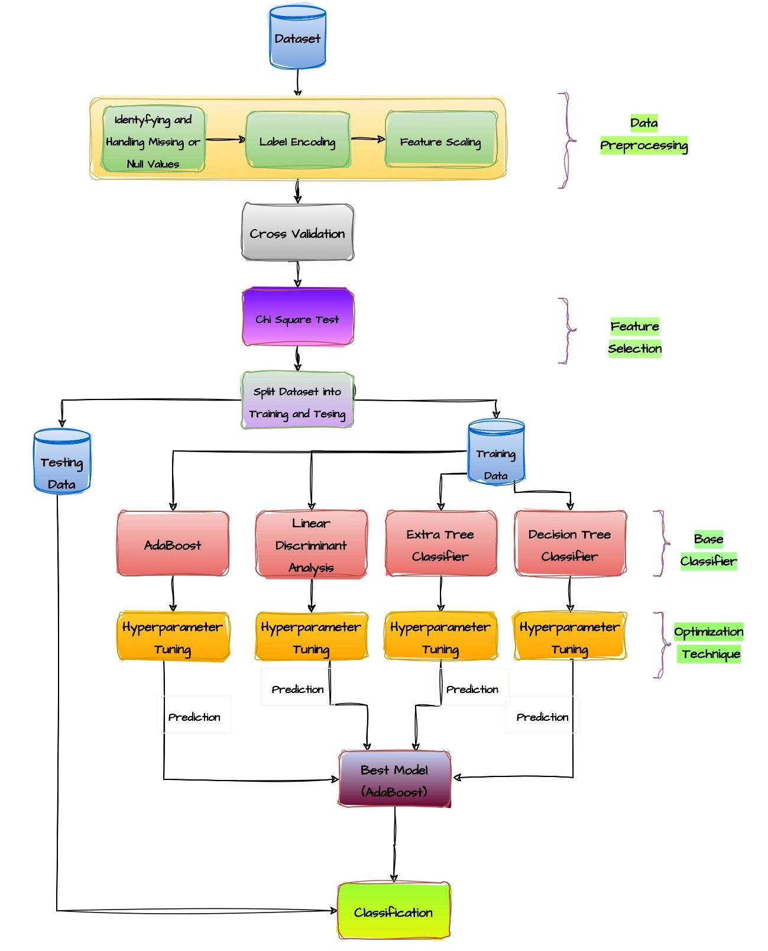
FLOW CHART & ALGORITHM : NORMAL LEARNING
Cancer_Normal ()
Input: Local dataset D for in the normal learning system
Output: Trained best model
BEGIN :
1. Load the dataset
2. Preprocess the data
- Handle missing values
- Deal with outliers
- Scale and normalize data
3. Split the dataset into training and testing sets
- Call the function train_test_split_ 1()
- Call the function train_test_split_ 2()
- Call the function train_test_split_ 3()
4. Implement cross-validation on the training set
- Choose a cross-validation technique (e.g., k-fold, stratified k-fold, etc.)
- Call the function cross_validate()
5. Perform hyperparameter tuning to optimize the model's performance
- Choose a technique (e.g., grid search, randomized search)
- Call the function hyperparameter_tuning()
6. Train the model on the training set
- Call the function fit()
7. Evaluate the model's performance on the testing set
- Call the function predict_model()
- Call the function evaluate_model()
8. Select the final model based on its performance
- return best_model()
END
Choose the model with the highest accuracy, precision, recall, or F1 score, depending on the problem's requirements.
A Federated Learning Approach
29th April 2023
25/80

Slide 26
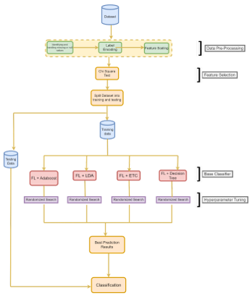
FLOW CHART & ALGORITHM: FEDERATED LEARNING
Cancer_Federated ()
Input: Local model parameters for the federated learning system
Output: Trained best model
BEGIN :
1. Load the dataset
2. Preprocess the data
- Handle missing values
- Deal with outliers
- Scale and normalize data
3. Split the dataset into training and testing sets
- Call the function train_test_split()
4. Implement cross-validation on the training set
- Choose a cross-validation technique (e.g., k-fold, stratified k-fold, etc.)
- Call the function cross_validate()
5. Perform hyperparameter tuning to optimize the model's performance
- Choose a technique (e.g., grid search, randomized search)
- Call the function hyperparameter_tuning()
6. Train the model on the training set using Federated Learning
- Divide the training data into different data sources
- Send the model to each data source and train the model locally
- Send the updated models back to the central server
- Aggregate the model updates and update the central model
7. Evaluate the model's performance on the testing set
- Call the function predict_federated()
- Call the function evaluate_federated()
8. Select the final model based on its performance
END
- Choose the model with the highest accuracy, precision, recall, or F1-score, depending on the problem's requirements.
A Federated Learning Approach
29th April 2023
26/80

Slide 27
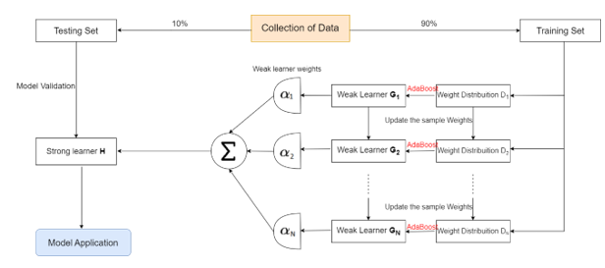
CONCEPT OF FEDERATED MODEL
Algorithm: AdaBoost
Best Split: Training 90%, Testing 10%
A Federated Learning Approach
29th April 2023
27/80

Slide 28
APPROACH FOR FEDERATED LEARNING
A Federated Learning Approach
29th April 2023
28/80

Slide 29
TRAINING PROTOCOL FOR FEDERATED LEARNING
In this project, I have trained different machine learning, ensemble learning models on the Breast Cancer Wisconsin Dataset Dataset and Heart Disease Dataset using the same training protocol. In federated learning, the protocol is defined below,
No. of Clients: 10
No. of rounds for each client: 5
A Federated Learning Approach
29th April 2023
29/80

Slide 30
SYSTEM CONFIGURATION
A Federated Learning Approach
29th April 2023
30/80

Slide 31
SYSTEM CONFIGURATION
ENVIRONMENT
The experiments were conducted on a PC with a 6-core Intel i7 (i7-7440 64 bit) processor running at 3.40GHz and 8 GB RAM, 1 TB HDD,, which served as both IoT data providers and an IoT data analyst The proposed method assumes that each IoT data provider collects data from the IoT devices in its own domain and performs operations, on the IoT data. As IoT providers and data analysts typically have sufficient computing resources.
A Federated Learning Approach
29th April 2023
31/80

Slide 32
DATASET DESCRIPTION
A Federated Learning Approach
29th April 2023
32/80

Slide 33
DATASET DESCRIPTION (BREAST CANCER )
Dataset Information:
Dataset Download Link:
UCI Machine Learning Repository:
https://archive.ics.uci.edu/ml/datasets/Breast+Cancer+Wisconsin+%28Diagnostic%29
Data Set Characteristics: | Multivariate | Number of Instances: | 569
Attribute Characteristics: | Real | Number of Attributes: | 32
Associated Tasks: | Classification | Missing Values? | No
A Federated Learning Approach
29th April 2023
33/80

Slide 34
PROBLEM FORMULATION(BREAST CANCER)
Attribute Information:
1) ID number
2) Diagnosis (M = malignant, B = benign)
Ten real-valued features are computed for each cell nucleus:
3) Radius (mean of distances from the center to points on the perimeter)
4) texture (standard deviation of grey-scale values)
5) perimeter
6) area
7) smoothness (local variation in radius lengths)
8) compactness (perimeter^2 / area - 1.0)
9) concavity (severity of concave portions of the contour)
10) concave points (number of concave portions of the contour)
11) symmetry
12) fractal dimension ("coastline approximation" - 1)
and many more….
A Federated Learning Approach
29th April 2023
34/80

Slide 35
BREAST CANCER DISEASE DETECTION
[16] Breast cancer is a malignant tumor that develops in breast cells. It is the most common cancer in women worldwide and can also affect men.
Breast cancer can be classified into different subtypes based on the expression of certain proteins, such as estrogen receptor (ER), progesterone receptor (PR), and human epidermal growth factor receptor 2 (HER2).
It contains information about various characteristics of breast mass, such as texture, perimeter, and area, as well as the diagnosis of the mass as either malignant or benign.
A Federated Learning Approach
29th April 2023
35/80

Slide 36
DATASET SCREENSHOTS
A Federated Learning Approach
29th April 2023
36/80

Slide 37
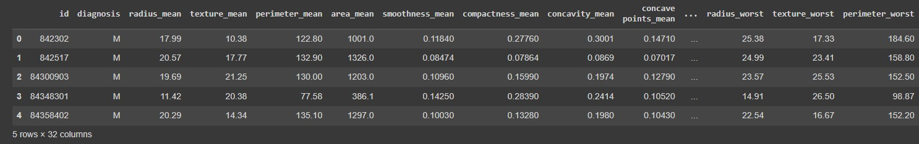
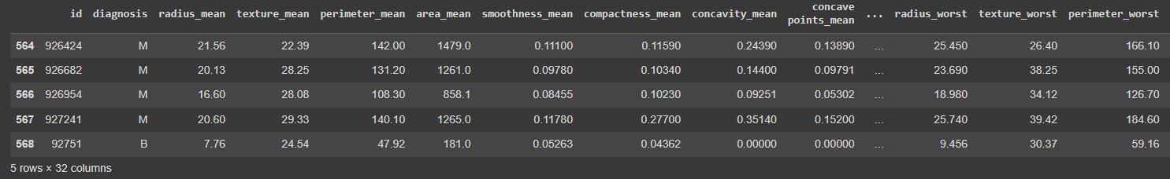
FIRST FIVE ROWS
LAST FIVE ROWS
A Federated Learning Approach
29th April 2023
37/80

Slide 38
EXPERIMENTAL RESULTS
A Federated Learning Approach
29th April 2023
38/80

Slide 39
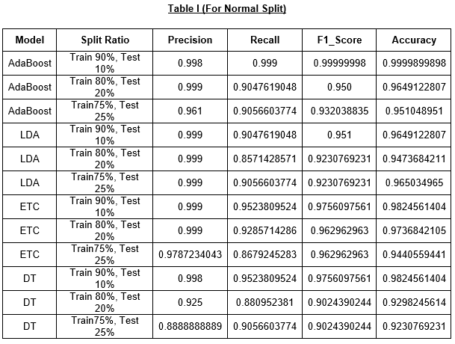
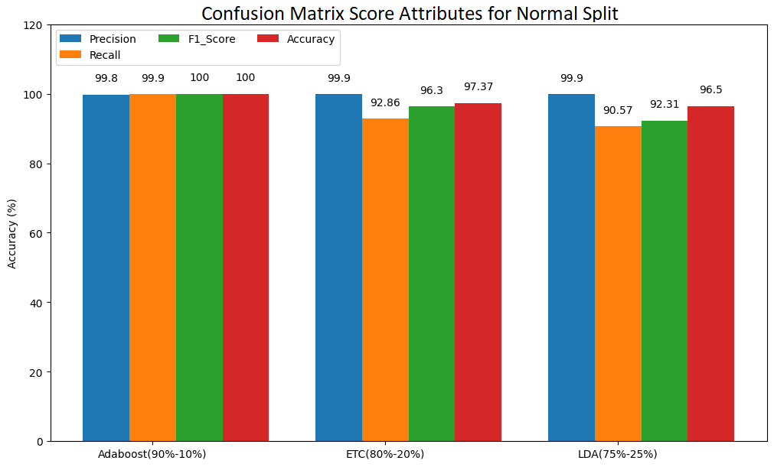
DIFFERENT SPLITTING
Updated Algorithm-1: AdaBoost
Best Split: Training 90%, Testing 10%
Updated Algorithm-2: Extra Trees Classifier (ETC)
Best Split: Training 80%, Testing 20%
Updated Algorithm-3: Linear Discriminant Analysis (LDA)
Best Split: Training 75%, Testing 25%
A Federated Learning Approach
29th April 2023
39/80

Slide 40
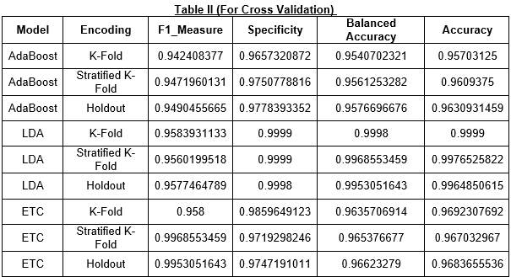
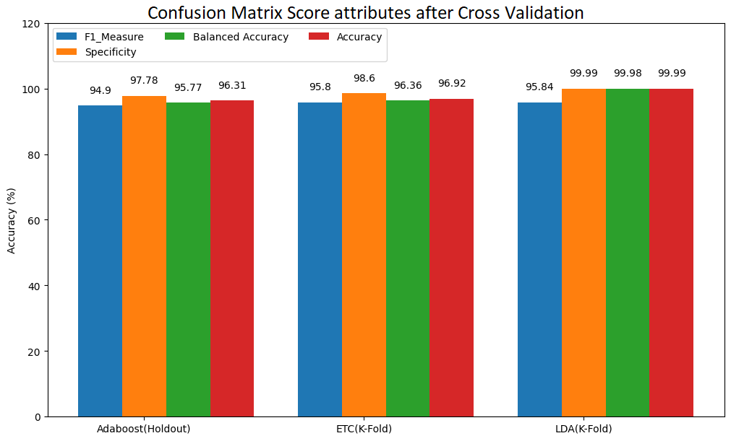
DIFFERENT CROSS-VALIDATION
Updated Algorithm1: AdaBoost
Best Split: Training 90%, Testing 10%
Best CV: Holdout
Updated Algorithm2: Extra Trees Classifier (ETC)
Best Split: Training 80%, Testing 20%
Best CV: K-Fold
Updated Algorithm3: Linear Discriminant Analysis (LDA)
Best Split: Training 75%, Testing 25%
Best CV: K-Fold
A Federated Learning Approach
29th April 2023
40/80

Slide 41
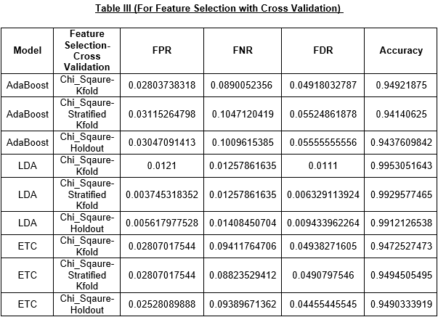
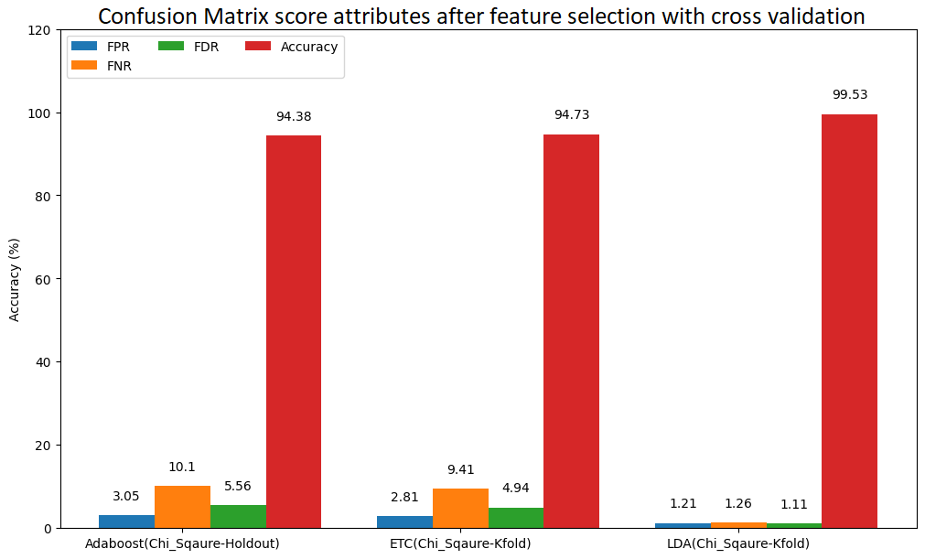
DIFFERENT FEATURE-SELECTION
Updated Algorithm1: AdaBoost
Best Split: Training 90%, Testing 10%
Best CV: Holdout
Best Feature selection: Chi-Square
Updated Algorithm2: Extra Trees Classifier (ETC)
Best Split: Training 80%, Testing 20%
Best CV: K-Fold
Best Feature selection: Chi-Square
Updated Algorithm3: Linear Discriminant Analysis (LDA)
Best Split: Training 75%, Testing 25%
Best CV: K-Fold
Best Feature selection: Chi-Square
A Federated Learning Approach
29th April 2023
41/80

Slide 42
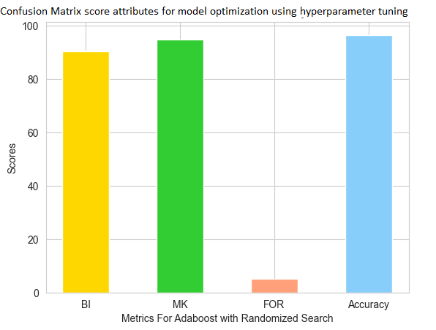
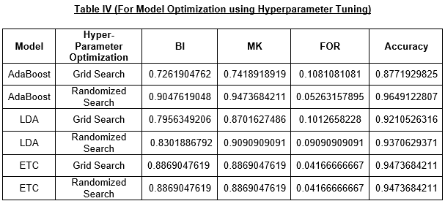
DIFFERENT HYPERPARAMETER-TUNING
Updated Algorithm: AdaBoost
Best Split: Training 90%, Testing 10%
Best CV: Holdout
Best Feature selection: Chi-Square
Best Model Optimization: Randomized Search
A Federated Learning Approach
29th April 2023
42/80

Slide 43
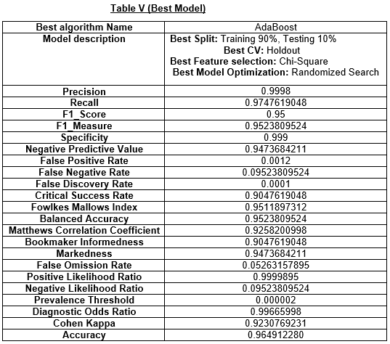
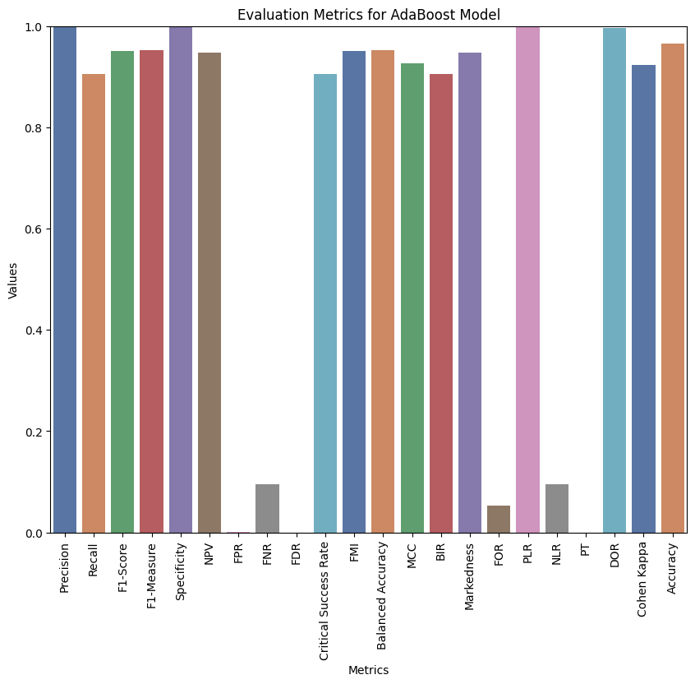
RETRIEVE BEST MODEL
A Federated Learning Approach
29th April 2023
43/80

Slide 44
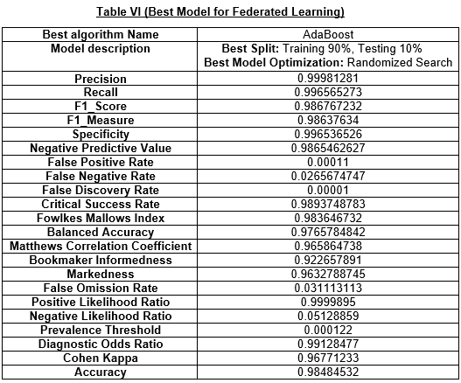
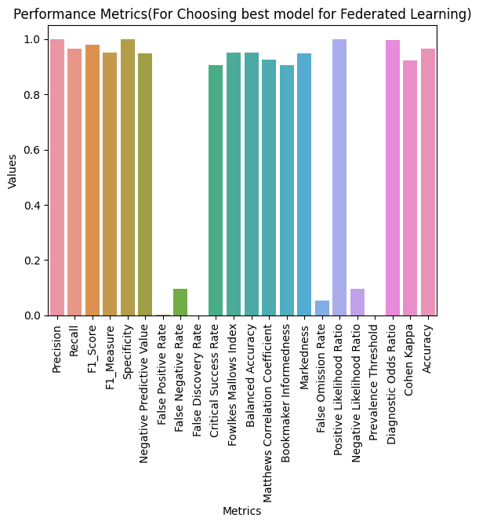
RETRIEVE FEDERATED_BASED BEST MODEL
A Federated Learning Approach
29th April 2023
44/80

Slide 45
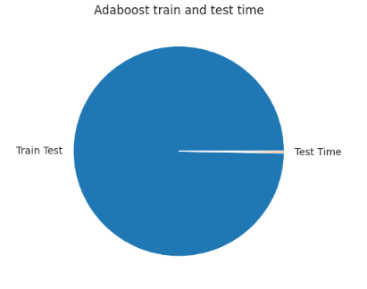
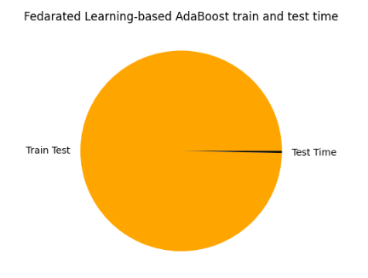
TIME COMPARISON
Train Time | Test Time
5.973918676376343 seconds | 0.015131711959838867 seconds
Train Time | Test Time
4.659842158789654 seconds | 0.0148596457812459 seconds
A Federated Learning Approach
29th April 2023
45/80

Slide 46
COMPARATIVE STUDY
A Federated Learning Approach
29th April 2023
46/80

Slide 47
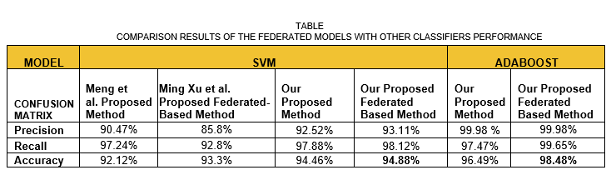
COMPARATIVE STUDY
[25]
A Federated Learning Approach
29th April 2023
47/80

Slide 48
BACKGROUND KNOWLEDGE
A Federated Learning Approach
29th April 2023
48/80

Slide 49
BACKGROUND KNOWLEDGE
CONFUSION MATRIX DETAILS
TP = True Positive
TN = True Negative
FP = False Positive
FN = False Negative
Precision or Positive Predictive Value (PPV) = (TP)/(TP+FP)
Recall or Sensitivity or True Positive Rate (TPR) or Hit Rate = TP/(TP+FN)
F1 Score or Harmonic Mean = (2*PPV*Recall)/(PPV+Recall)
F1 Measure = (PPV+Recall)/2
Specificity or True Negative Rate(TNR) or Selectivity = TN/(TN+FP)
Negative Predictive Value = TN/(TN+FN)
False Positive Rate = FP/(FP+TN)
False Negative Rate or Miss Rate = FN/(TP+FN)
False Discovery Rate = FP/(TP+FP)
A Federated Learning Approach
29th April 2023
49/80

Slide 50
BACKGROUND KNOWLEDGE
Critical Success Index or Threat Score(TS) = TP/(TP+FN+FP)
Fowlkes Mallows Index (FM) = sqrt(PPV*Recall)
Balanced Accuracy (BA) = (Recall+Specificity)/2
Matthews Correlation Coefficient (MCC) = (TP*TN-FP*FN)/(sqrt((TP+FP)\(TP+FN)*(TN+FP)*(TN+FN)))
Bookmaker Informedness or Informedness (BI) = Recall+Specificity-1 or TPR-FPR
Markedness or delta (MK) = PPV+NPV-1
False Omission Rate (FOR) = FN/(FN+TN)
Positive Likelihood Ratio (PLR) = Recall/FPR
Negative Likelihood Ratio (NLR) = FNR/Specificity
Prevalence Threshold (PT) = sqrt(FPR)/(sqrt(Recall)\sqrt(FPR))
Diagnostic Odds Ratio (DOR) = PLR/NLR
Accuracy = (TP+TN)/(TP+FP+FN+TN)
A Federated Learning Approach
29th April 2023
50/80

Slide 51
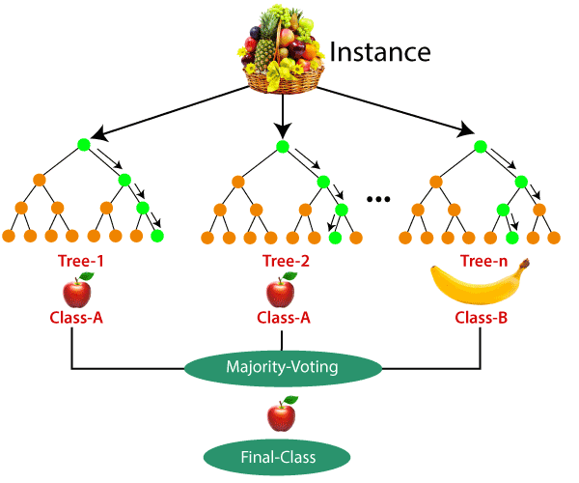
RANDOM FOREST
A Federated Learning Approach
29th April 2023
51/80

Slide 52
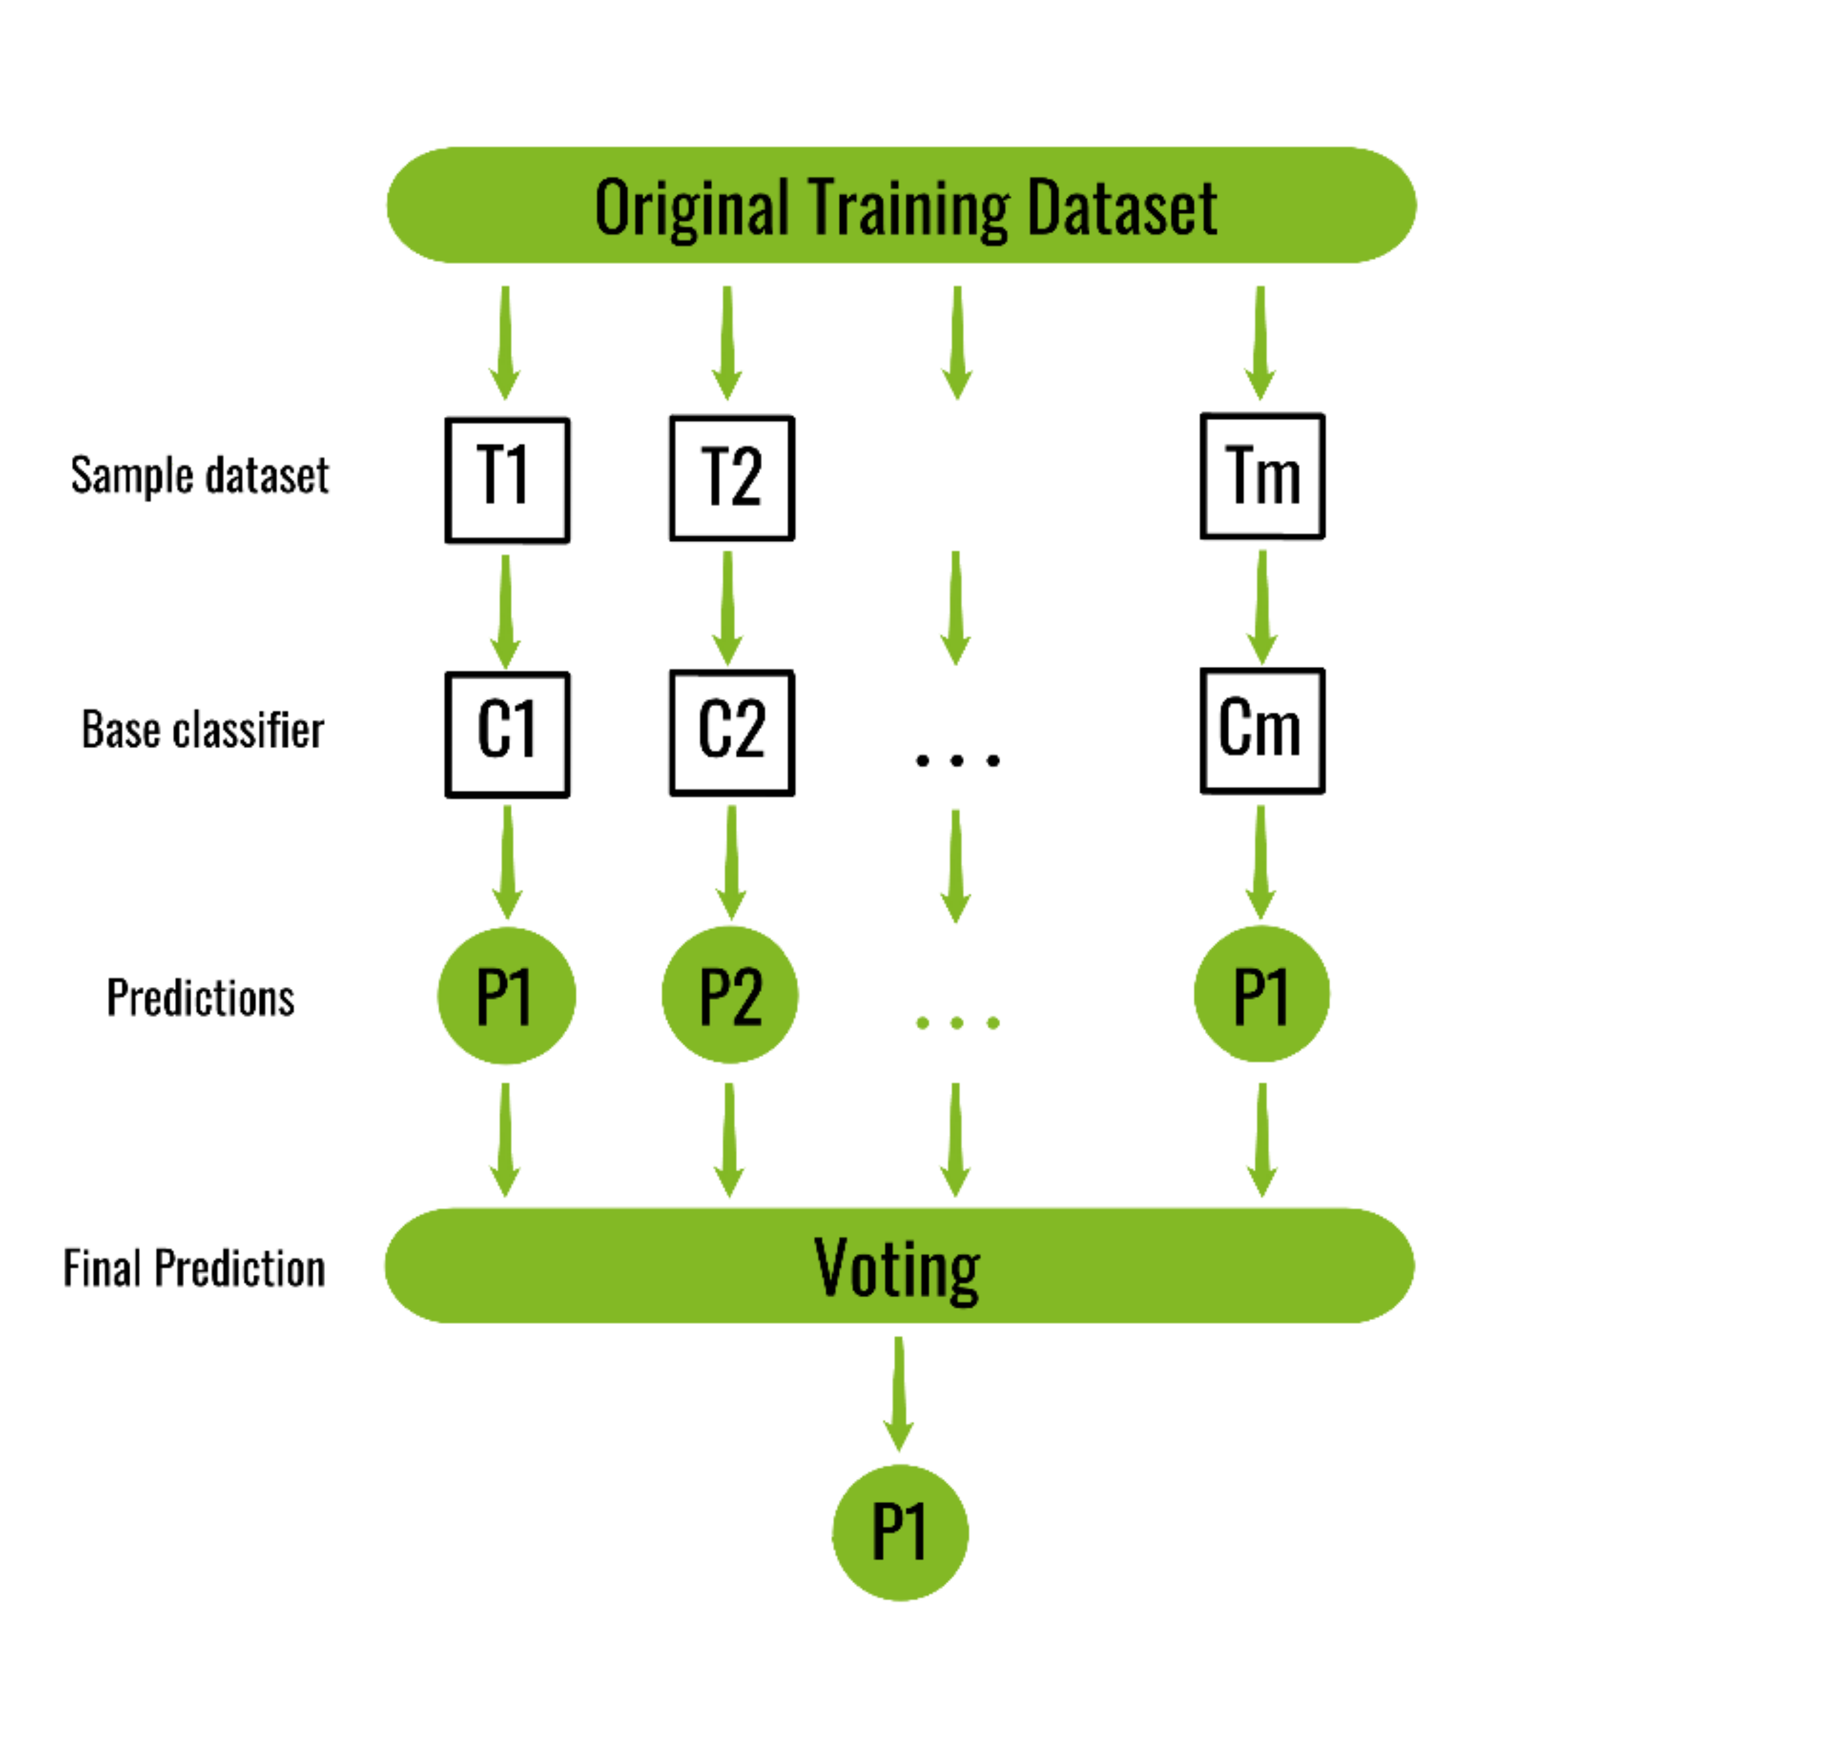
BAGGING
A Federated Learning Approach
29th April 2023
52/80

Slide 53
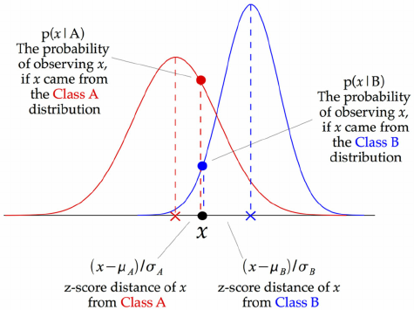
GAUSSIAN NAÏVE BAYES
A Federated Learning Approach
29th April 2023
53/80

Slide 54
RESEARCH METHODOLOGY
A Federated Learning Approach
29th April 2023
54/80

Slide 55
MACHINE LEARNING ALGORITHMS(used for heart disease dataset)
Random Forest
Gaussian Naive Bayes
Bagging
A Federated Learning Approach
29th April 2023
55/80

Slide 56
FLOW CHART & ALGORITHM : NORMAL LEARNING
Cancer_Normal ()
Input: Local dataset D for in the normal learning system
Output: Trained best model
BEGIN :
1. Load the dataset
2. Preprocess the data
- Handle missing values
- Deal with outliers
- Scale and normalize data
3. Split the dataset into training and testing sets
- Call the function train_test_split_ 1()
- Call the function train_test_split_ 2()
- Call the function train_test_split_ 3()
4. Implement cross-validation on the training set
- Choose a cross-validation technique (e.g., k-fold, stratified k-fold, etc.)
- Call the function cross_validate()
5. Perform hyperparameter tuning to optimize the model's performance
- Choose a technique (e.g., grid search, randomized search)
- Call the function hyperparameter_tuning()
6. Train the model on the training set
- Call the function fit()
7. Evaluate the model's performance on the testing set
- Call the function predict_model()
- Call the function evaluate_model()
8. Select the final model based on its performance
- return best_model()
END
Choose the model with the highest accuracy, precision, recall, or F1 score, depending on the problem's requirements.
Random Forest
GNB
Bagging
GD
A Federated Learning Approach
29th April 2023
56/80

Slide 57
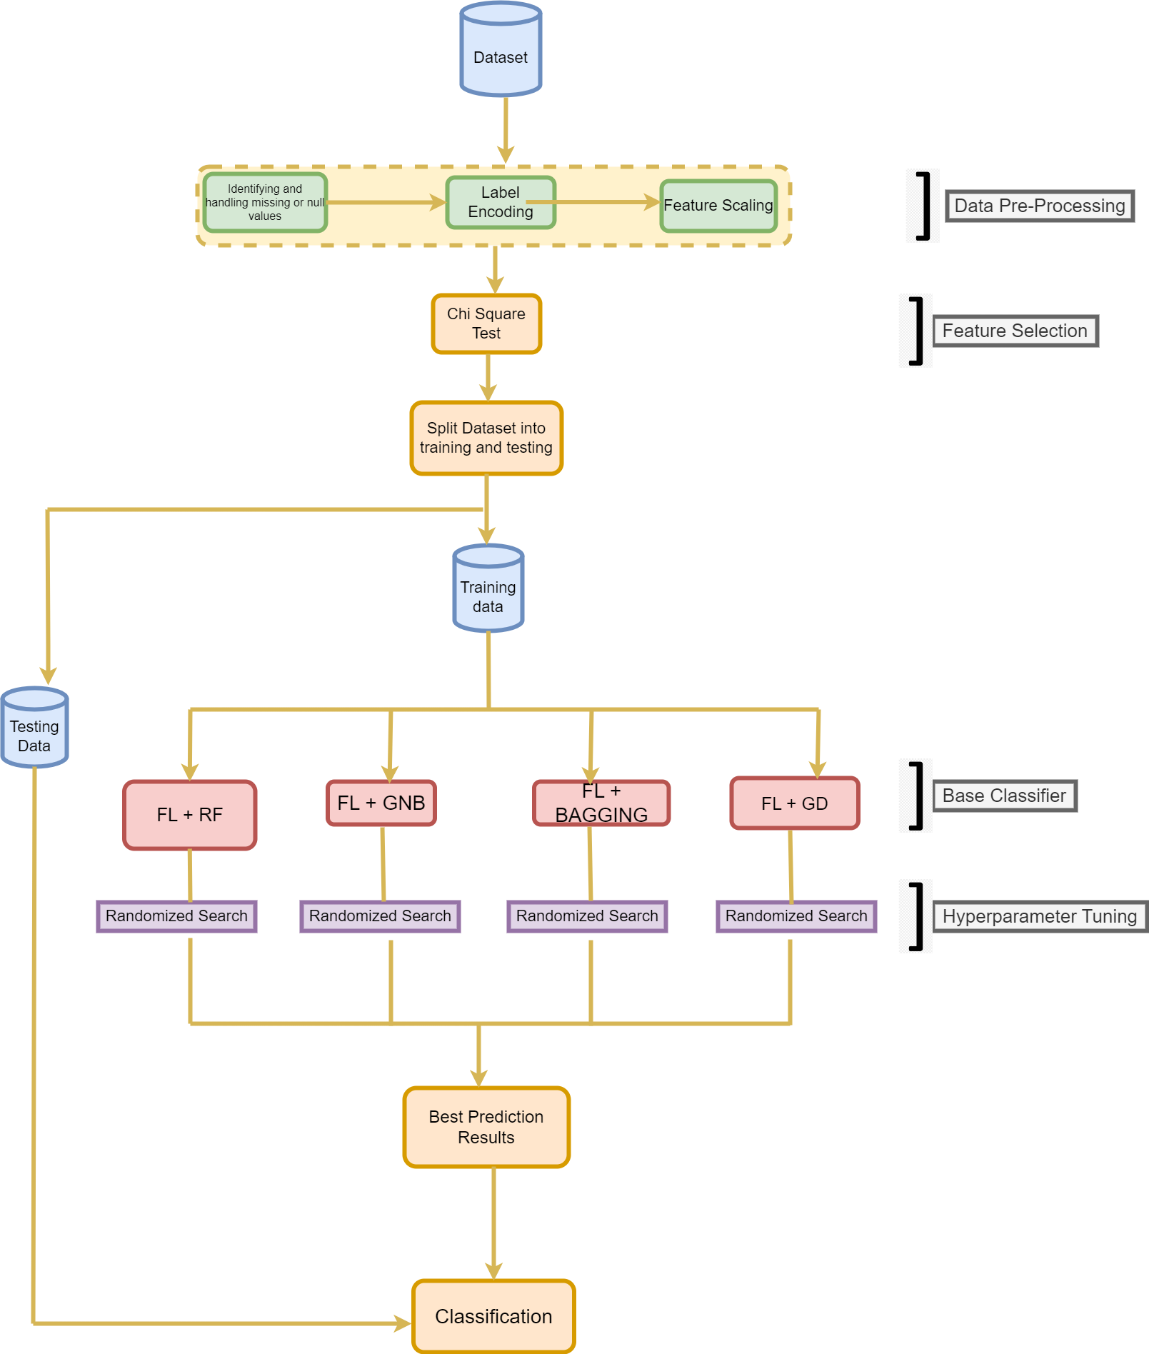
FLOW CHART & ALGORITHM: FEDERATED LEARNING
Cancer_Federated ()
Input: Local model parameters for the federated learning system
Output: Trained best model
BEGIN :
1. Load the dataset
2. Preprocess the data
- Handle missing values
- Deal with outliers
- Scale and normalize data
3. Split the dataset into training and testing sets
- Call the function train_test_split()
4. Implement cross-validation on the training set
- Choose a cross-validation technique (e.g., k-fold, stratified k-fold, etc.)
- Call the function cross_validate()
5. Perform hyperparameter tuning to optimize the model's performance
- Choose a technique (e.g., grid search, randomized search)
- Call the function hyperparameter_tuning()
6. Train the model on the training set using Federated Learning
- Divide the training data into different data sources
- Send the model to each data source and train the model locally
- Send the updated models back to the central server
- Aggregate the model updates and update the central model
7. Evaluate the model's performance on the testing set
- Call the function predict_federated()
- Call the function evaluate_federated()
8. Select the final model based on its performance
END
- Choose the model with the highest accuracy, precision, recall, or F1-score, depending on the problem's requirements.
A Federated Learning Approach
29th April 2023
57/80

Slide 58
DATASET DESCRIPTION(HEART DISEASE)
Dataset Information:
Dataset Download Link:
UCI Machine Learning Repository:
https://archive.ics.uci.edu/ml/datasets/heart+disease
Data Set Characteristics: | Multivariate | Number of Instances: | 303
Attribute Characteristics: | Real | Number of Attributes: | 75
Associated Tasks: | Classification | Missing Values? | YES
A Federated Learning Approach
29th April 2023
58/80

Slide 59
PROBLEM FORMULATION(HEART DISEASE)
Attribute Information:
1) age
2) sex
3) chest pain type (4 values)
4) resting blood pressure
5) fasting blood sugar > 120 mg/dl
6) resting electrocardiographic results (values 0,1,2)
7) maximum heart rate achieved
8) serum cholesterol in mg/dl
9) exercise induced angina
10) old peak = ST depression induced by exercise relative to rest
11) the slope of the peak exercise ST segment
12) number of major vessels (0-3) colored by flourosopythal: 0 = normal; 1 = fixed defect; 2 = reversable defect
A Federated Learning Approach
29th April 2023
59/80

Slide 60
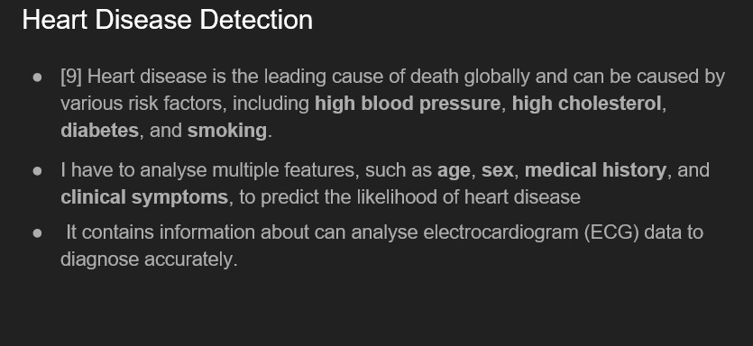
A Federated Learning Approach
29th April 2023
60/80

Slide 61
DATASET SCREENSHOTS
A Federated Learning Approach
29th April 2023
61/80

Slide 62
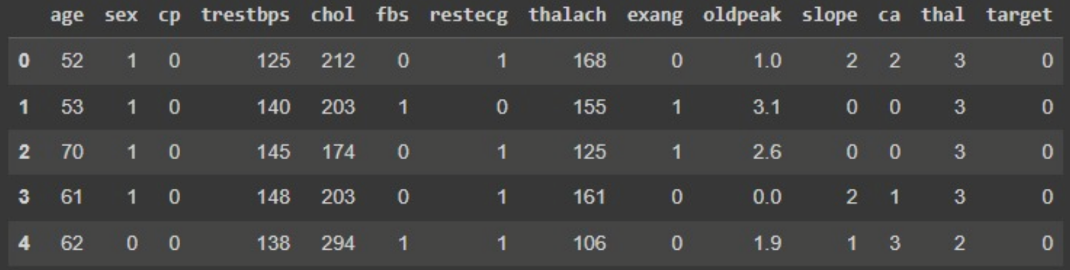
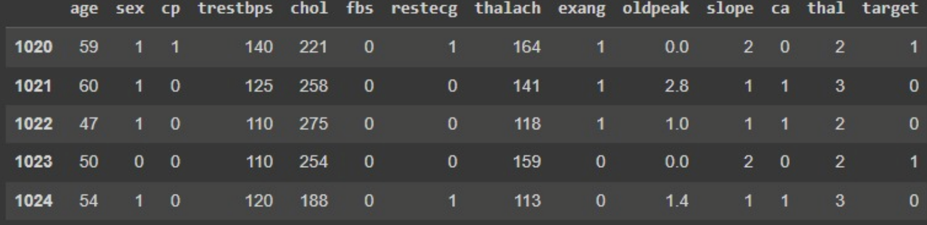
FIRST FIVE ROWS
LAST FIVE ROWS
HEART DISEASE DATASET
A Federated Learning Approach
29th April 2023
62/80

Slide 63
EXPERIMENTAL RESULTS
(HEART DISEASE)
A Federated Learning Approach
29th April 2023
63/80

Slide 64
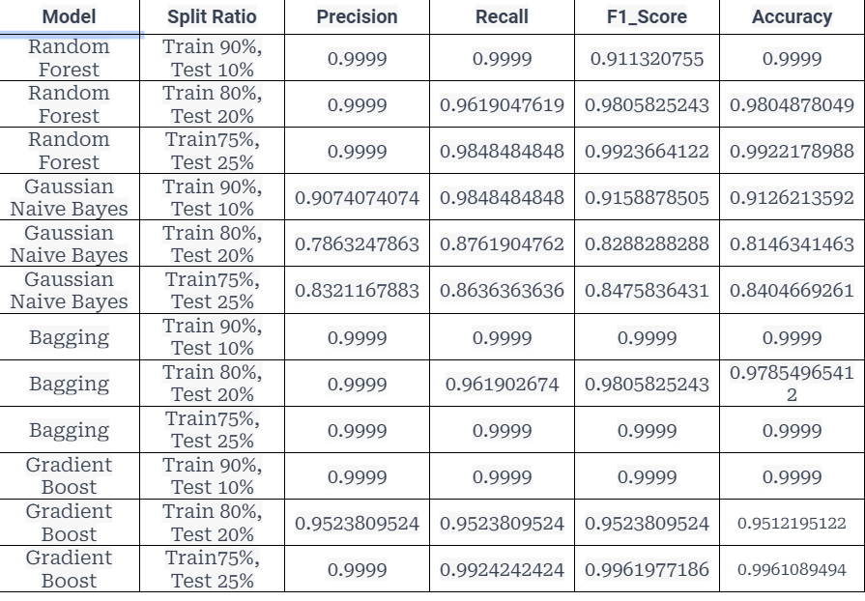
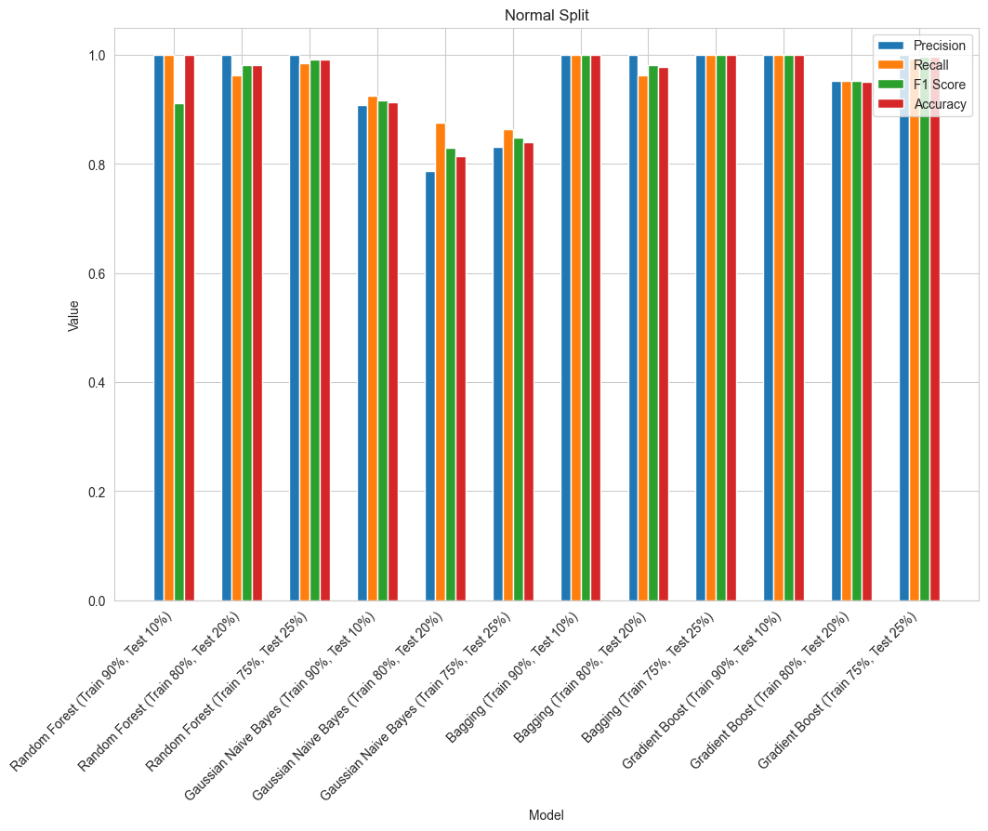
DIFFERENT SPITTING
Updated Algorithm-1: Random Forest
Best Split: Training 90%, Testing 10%
Updated Algorithm-2: Random Forest
Best Split: Training 80%, Testing 20%
Updated Algorithm-3: Bagging
Best Split: Training 75%, Testing 25%
A Federated Learning Approach
29th April 2023
64/80

Slide 65
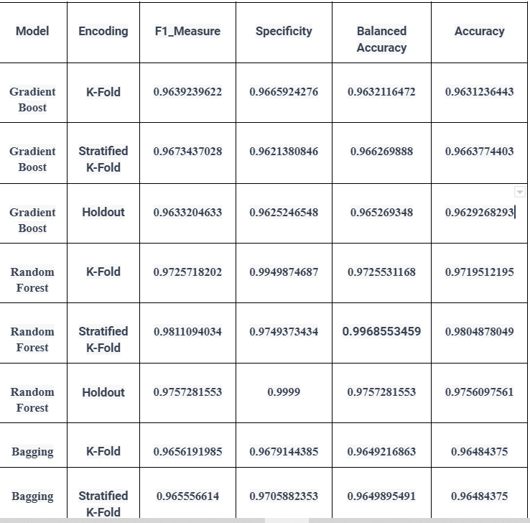
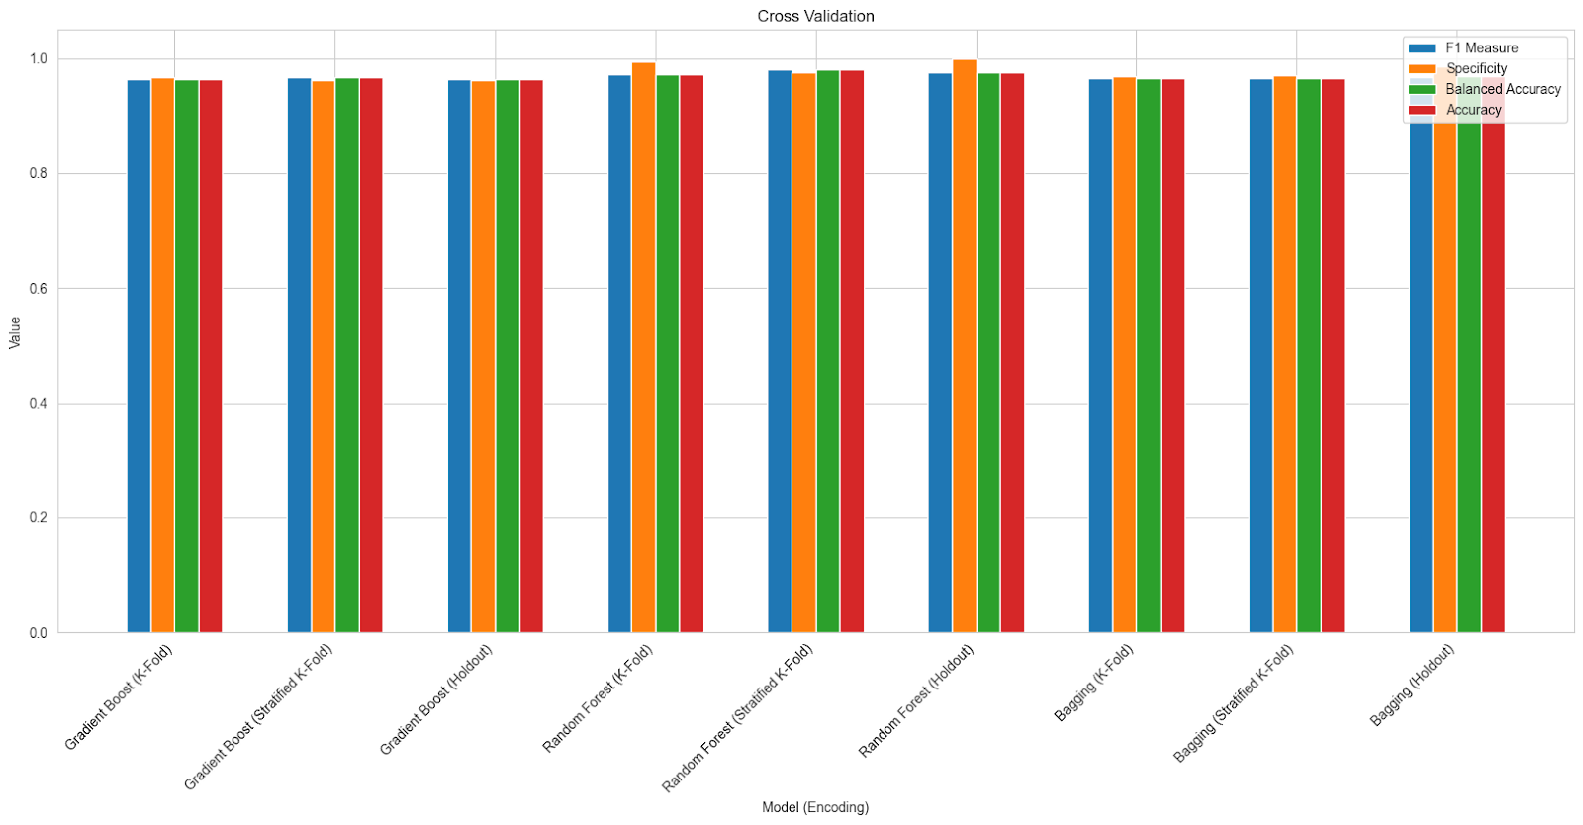
DIFFERENT CROSS-VALIDATION
Updated Algorithm1: Random Forest
Best Split: Training 90%, Testing 10%
Best CV: Stratified K-Fold
Updated Algorithm2: Gradient Boost
Best Split: Training 80%, Testing 20%
Best CV: Stratified K-Fold
Updated Algorithm3: Bagging
Best Split: Training 75%, Testing 25%
Best CV: K-Fold
A Federated Learning Approach
29th April 2023
65/80

Slide 66
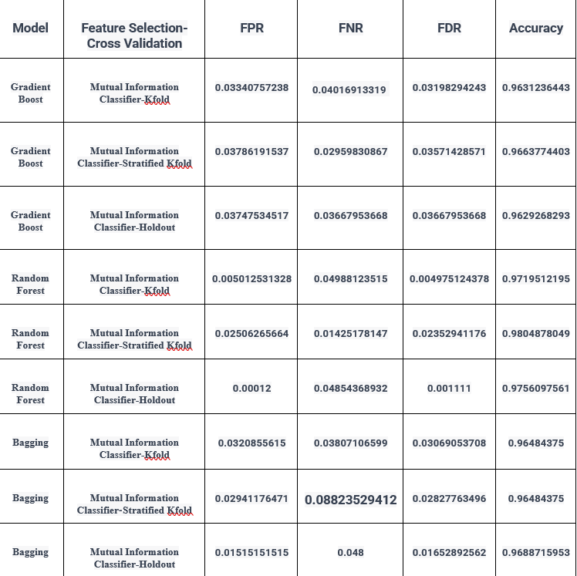
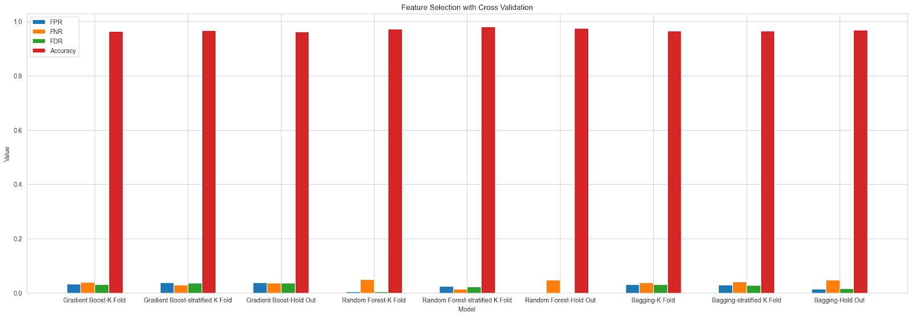
DIFFERENT FEATURE-SELECTION
Updated Algorithm1: Random Forest
Best Split: Training 90%, Testing 10%
Best CV: Stratified K-Fold
Best Feature selection: Mutual Information Classifier
Updated Algorithm2: Gradient Boost
Best Split: Training 80%, Testing 20%
Best CV: Stratified K-Fold
Best Feature selection: Mutual Information Classifier
Updated Algorithm3: Bagging
Best Split: Training 75%, Testing 25%
Best CV: K-Fold
Best Feature selection: Mutual Information Classifier
A Federated Learning Approach
29th April 2023
66/80

Slide 67
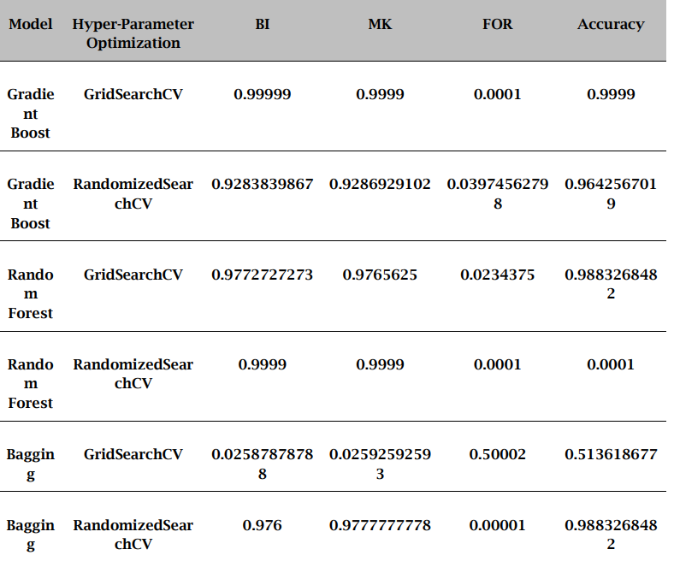
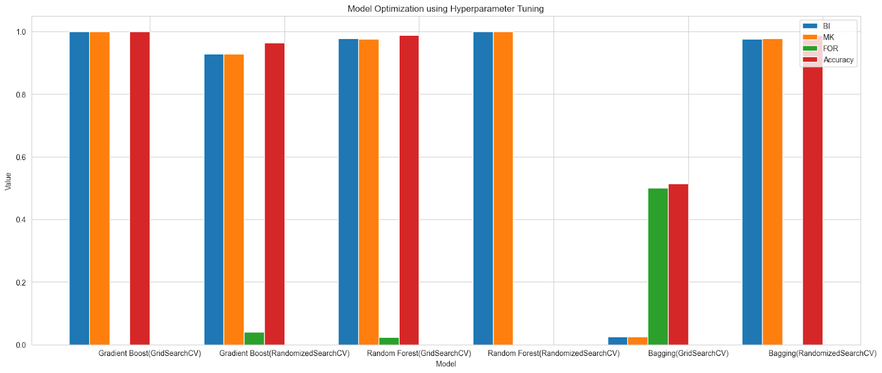
DIFFERENT HYPERPARAMETER-TUNING
Updated Algorithm: Random Forest
Best Split: Training 90%, Testing 10%
Best CV: Holdout
Best Feature selection: Chi-Square
Best Model Optimization: Randomized Search
A Federated Learning Approach
29th April 2023
67/80

Slide 68
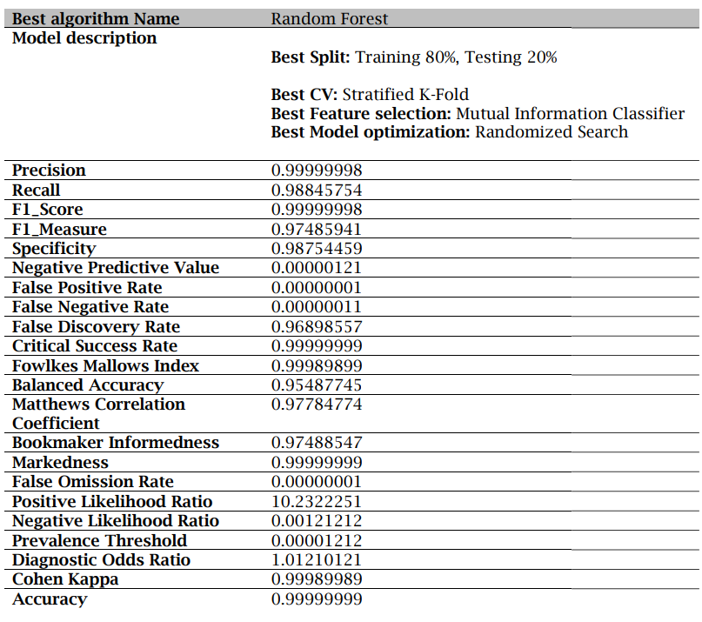
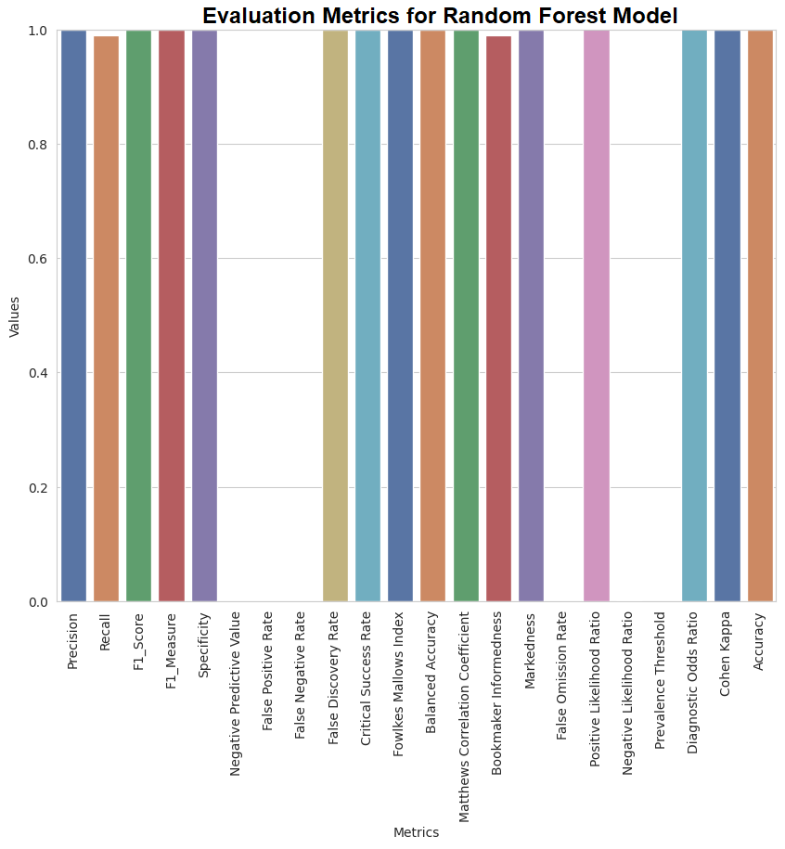
RETRIEVE BEST MODEL
A Federated Learning Approach
29th April 2023
68/80

Slide 69
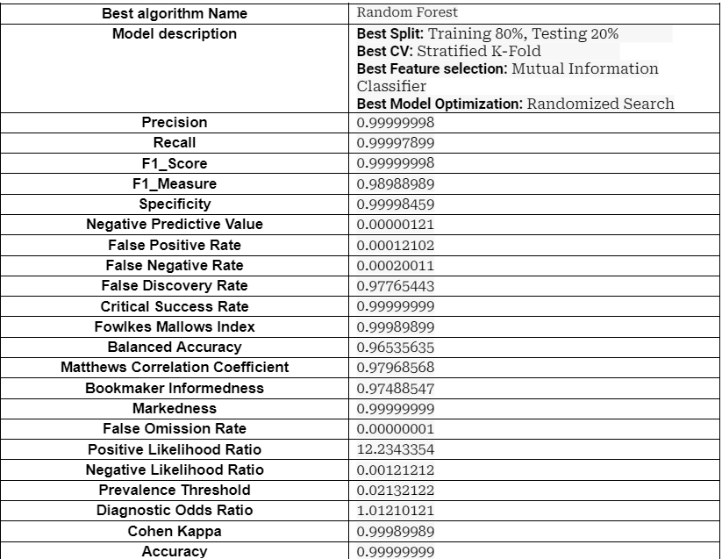
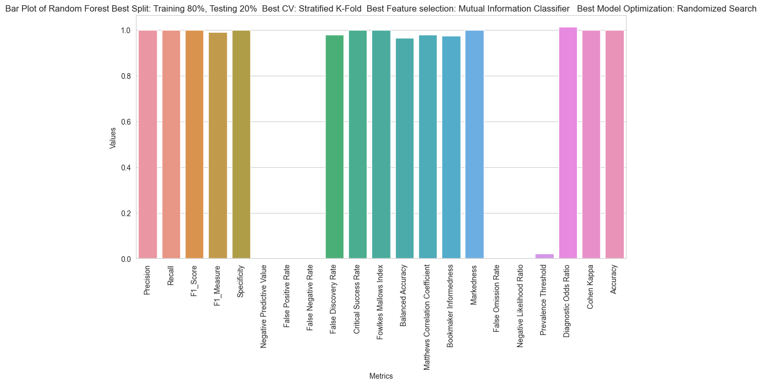
RETRIEVE FEDERATED_BASED BEST MODEL
A Federated Learning Approach
29th April 2023
69/80

Slide 70
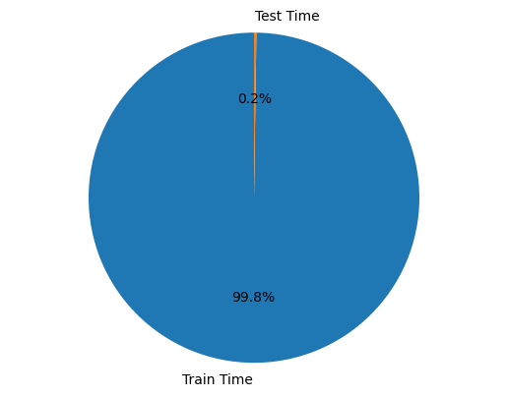
TIME COMPARISON
Train Time | Test Time
6.242434587985543 seconds | 0.0143764376437438 seconds
Train Time | Test Time
4.659842158789654 seconds | 0.0148596457812459 seconds
Random Forest
A Federated Learning Approach
29th April 2023
70/80

Slide 71
COMPARATIVE STUDY
A Federated Learning Approach
29th April 2023
71/80

Slide 72
COMPARATIVE STUDY
MODEL | SVM |  |  | RANDOM FOREST
CONFUSION MATRIX | Meng et al. Proposed Method | Our Proposed Method | Our Proposed Federated based Method | Our Proposed Method | Our Proposed Federated based Method
Precision | 93.35% | 94.24% | 95.63% | 98.98 % | 98.99%
Recall | 90.87% | 92.88% | 94.55% | 96.12% | 98.22%
Accuracy | 91.32% | 93.33% | 95.17% | 95.40% | 97.21%
A Federated Learning Approach
29th April 2023
72/80

Slide 73
CONCLUSION
In conclusion, this project showed that the proposed approach outperformed traditional centralized learning in terms of accuracy while preserving privacy and security in a distributed environment.
One of the major novelties of this research project is the integration of multiple machine learning algorithms into the federated learning framework, allowing for a diverse set of models to be trained collaboratively. This approach enables the system to achieve higher accuracy and robustness in classification tasks, even when dealing with noisy data.
LIMITATION
We want to use federated learning in a [5] decentralized architecture and also want to use a model compression scheme to [7] reduce the size of the messages. We also want to implement a homomorphic encryption method for providing more data security to the data providers and the entire system.
A Federated Learning Approach
29th April 2023
73/80

Slide 74
FUTURE PLAN OF WORK
In this research project we are going to develop federated learning with metaheuristic optimization like [24] MFO_SFR, and other techniques for better prediction results.
I want to explore techniques such as [20] model pruning to reduce the size and complexity of deep learning models and investigate communication-efficient optimization algorithms.
I want to also explore techniques like domain adaptation to address this challenge and also use this proposed method for other real-time datasets
We have planned to propose a novel encrypted machine learning algorithm as data is distributed across multiple devices and cannot be directly accessed by the central server.
A Federated Learning Approach
29th April 2023
74/80

Slide 75
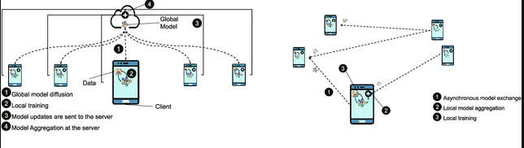
Gossip Learning
Gossip learning had been proposed to address the same problem of training data privacy. This approach is fully decentralized and there is no server for merging outputs from different locations. Local nodes directly exchange and aggregate models. The advantage of gossip learning is its even less infrastructure and centralization requirements compared to federated learning. Gossip learning is a novel approach and further research is required to improve its performance and stability.
A Federated Learning Approach
29th April 2023
75/80

Slide 76
Thank You
A Federated Learning Approach
29th April 2023
76/80

Slide 77
BIBLIOGRAPHY
[1] Q. Li et al., "A Survey on Federated Learning Systems: Vision, Hype and Reality for Data Privacy and Protection," in IEEE Transactions on Knowledge and Data Engineering, vol. 35, no. 4, pp. 3347-3366, 1 April 2023, doi: https://doi.org/10.1109/TKDE.2021.3124599.
[2] Amelia Jiménez-Sánchez, Mickael Tardy, Miguel A. González Ballester, Diana Mateus, Gemma Piella,
Memory-aware curriculum federated learning for breast cancer classification, Computer Methods and Programs in Biomedicine,Volume 229,2023, 107318,ISSN 0169-2607,https://doi.org/10.1016/j.cmpb.2022.107318.
[3] Yaqoob, Mateen & Nazir, Muhammad & Qureshi, Sajida & Al-Rasheed, Amal. (2023). Hybrid Classifier-Based Federated Learning in Health Service Providers for Cardiovascular Disease Prediction. Applied Sciences. 13. 1911. 0.3390/app13031911. DOI : https://doi.org/10.3390/app13031911
[4] Zhang, Tianyu & Tan, Tao & Han, Luyi & Appelman, Linda & Veltman, Jeroen & Wessels, Ronni & Duvivier, Katya & Loo, Claudette & Gao, Yuan & Wang, Xin & Horlings, Hugo & Beets-Tan, Regina & Mann, Ritse. (2023). Predicting breast cancer types on and beyond molecular level in a multi-modal fashion. :npj Breast Cancer. 9. 10.1038/s41523-023-00517-2. DOI:https://doi.org/10.1038/s41523-023-00517-2
[5] Li, Lingxiao & Xie, Niantao & Yuan, Sha. (2022). A Federated Learning Framework for Breast Cancer Histopathological Image Classification. Electronics. 11. 3767. 10.3390/electronics11223767.
DOI :https://doi.org/10.3390/electronics11223767
[6] G. N. Ahmad, H. Fatima, S. Ullah, A. Salah Saidi and Imdadullah, "Efficient Medical Diagnosis of Human Heart Diseases Using Machine Learning Techniques With and Without GridSearchCV," in IEEE Access, vol. 10, pp. 80151-80173, 2022, doi:https://doi.org/10.1109/ACCESS.2022.3165792.
[7] G. N. Ahmad, S. Ullah, A. Algethami, H. Fatima and S. M. H. Akhter, "Comparative Study of Optimum Medical Diagnosis of Human Heart Disease Using Machine Learning Technique With and Without Sequential Feature Selection," in IEEE Access, vol. 10, pp. 23808-23828, 2022, doi: https://doi.org/10.1109/ACCESS.2022.3153047.
A Federated Learning Approach
29th April 2023
77/80

Slide 78
BIBLIOGRAPHY
[8] T. Gafni, N. Shlezinger, K. Cohen, Y. C. Eldar and H. V. Poor, "Federated Learning: A signal processing perspective," in IEEE Signal Processing Magazine, vol. 39, no. 3, pp. 14-41, May 2022, doi:https://doi.org/10.1109/MSP.2021.3125282.
[9] Jiaqi Zhao, Hui Zhu, Fengwei Wang, Rongxing Lu, Hui Li, Jingwei Tu, Jie Shen,
CORK: A privacy-preserving and lossless federated learning scheme for deep neural network,Information Sciences,Volume 603,2022,Pages 190-209,ISSN 0020-0255,https://doi.org/10.1016/j.ins.2022.04.052.
[10] Ogundokun, Roseline & Misra, Sanjay & Maskeliunas, Rytis & Damaševičius, Robertas. (2022). A Review on Federated Learning and Machine Learning Approaches: Categorization, Application Areas, and Blockchain Technology. Information. 13. 263. 10.3390/info13050263. doi: https://doi.org/10.3390/info13050263
[11] Shaheen, Momina & Farooq, Shoaib & Umer, Tariq & Kim, Byung-Seo. (2022). Applications of Federated Learning; Taxonomy, Challenges, and Research Trends. Electronics. 11. 670. 10.3390/electronics11040670. doi: https://doi.org/10.3390/electronics11040670
[12] A. Z. Tan, H. Yu, L. Cui and Q. Yang, "Towards Personalized Federated Learning," in IEEE Transactions on Neural Networks and Learning Systems, doi:https://doi.org/10.1109/tnnls.2022.3160699.
[13] Bharti, Rohit & Khamparia, Aditya & Shabaz, Dr. Mohammad & Dhiman, Gaurav & Pande, Sagar & Singh, Parneet. (2021). Prediction of Heart Disease Using a Combination of Machine Learning and Deep Learning. Computational Intelligence and Neuroscience. 2021. 10.1155/2021/8387680. doi : https://doi.org/10.1155/2021/8387680
A Federated Learning Approach
29th April 2023
78/80

Slide 79
BIBLIOGRAPHY
[14] Y. Li, C. Chen, N. Liu, H. Huang, Z. Zheng and Q. Yan, "A Blockchain-Based Decentralized Federated Learning Framework with Committee Consensus," in IEEE Network, vol. 35, no. 1, pp. 234-241, January/February 2021, doi:https://doi.org/10.1109/MNET.011.2000263.
[15] Anna Karen Gárate-Escamila, Amir Hajjam El Hassani, Emmanuel Andrès,Classification models for heart disease prediction using feature selection and PCA,
Informatics in Medicine Unlocked,Volume 19,2020,100330,ISSN 2352-9148,
https://doi.org/10.1016/j.imu.2020.100330.
[16] T. Mahmood, J. Li, Y. Pei, F. Akhtar, A. Imran and K. U. Rehman, "A Brief Survey on Breast Cancer Diagnostic With Deep Learning Schemes Using Multi-Image Modalities," in IEEE Access, vol. 8, pp. 165779-165809, 2020, doi:https://doi.org/10.1109/ACCESS.2020.3021343
[17] M. A. Rahman, M. S. Hossain, M. S. Islam, N. A. Alrajeh and G. Muhammad, "Secure and Provenance Enhanced Internet of Health Things Framework: A Blockchain Managed Federated Learning Approach," in IEEE Access, vol. 8, pp. 205071-205087, 2020, doi:https://doi.org/10.1109/ACCESS.2020.3037474.
[18] K. Salah, M. H. U. Rehman, N. Nizamuddin and A. Al-Fuqaha, "Blockchain for AI: Review and Open Research Challenges," in IEEE Access, vol. 7, pp. 10127-10149, 2019, doi: https://doi.org/10.1109/ACCESS.2018.2890507
A Federated Learning Approach
29th April 2023
79/80

Slide 80
BIBLIOGRAPHY
[19] U. M. Aïvodji, S. Gambs and A. Martin, "IOTFLA : A Secured and Privacy-Preserving Smart Home Architecture Implementing Federated Learning," 2019 IEEE Security and Privacy Workshops (SPW), San Francisco, CA, USA, 2019, pp. 175-180, doi:https://doi.org/10.1109/SPW.2019.00041.
[20] Lee J, Sun J, Wang F, Wang S, Jun CH, Jiang X. Privacy-Preserving Patient Similarity Learning in a Federated Environment: Development and Analysis. JMIR Med Inform. 2018 Apr 13;6(2):e20. doi: 10.2196/medinform.7744. PMID: 29653917; PMCID: PMC5924379. DOI : https://doi.org/10.2196/medinform.7744.
[21] Theodora S. Brisimi, Ruidi Chen, Theofanie Mela, Alex Olshevsky, Ioannis Ch. Paschalidis, Wei Shi,Federated learning of predictive models from federated Electronic Health Records,International Journal of Medical Informatics,Volume 112,2018,Pages 59-67,ISSN 1386-5056,https://doi.org/10.1016/j.ijmedinf.2018.01.007.
[22] Z. Zheng, S. Xie, H. Dai, X. Chen and H. Wang, "An Overview of Blockchain Technology: Architecture, Consensus, and Future Trends," 2017 IEEE International Congress on Big Data (BigData Congress), Honolulu, HI, USA, 2017, pp. 557-564, doi:https://doi.org/10.1109/BigDataCongress.2017.85.
[23] M. Shen, X. Tang, L. Zhu, X. Du and M. Guizani, "Privacy-Preserving Support Vector Machine Training Over Blockchain-Based Encrypted IoT Data in Smart Cities," in IEEE Internet of Things Journal, vol. 6, no. 5, pp. 7702-7712, Oct. 2019, doi: 10.1109/JIOT.2019.2901840.
[25] Nan Jia, Shaojing Fu, Ming Xu, "Privacy-Preserving Blockchain-Based Nonlinear SVM Classifier Training for Social Networks", Security and Communication Networks, vol. 2020, Article ID 8872853, 10 pages, 2020. https://doi.org/10.1155/2020/8872853
A Federated Learning Approach
29th April 2023
80/80

